Slide 1
GIT
P J Manu Prathap

Slide 2
What is GIT ?
Git is a distributed version control system used for source code management.
Git used to track changes in the source code.
Allows multiple developers to work together.
Git is a software tool and git hub is a services.
In git hub ,it uses graphical interface to store the files were as in git ,It provides command line to interact with files.

Slide 3
GIT Commands
git --version : Shows the version number of the git that is installed.
git config --global user.name “username” : identity configuration
git config --global email.name ”email ID” : email configuration
git config --global core.editor “code --wait”: setting up the editor

Slide 4
git config --global –e :Edit global config from editor
git init : Initialized Empty Git Repository.
git add. : Everything in a project is added to the index.
git add <filename> : The corresponding file is added to the index.
git commit -m “msg” : the project is placed into the Repository.
git commit -a : adding and commiting files
git remote add origin url: to add files to remoterepository

Slide 5
git log : shows the information about the file such as commit Id ,Author, Date of file created.
git log 1: it returns only last staged file.
git log --oneline : list the information of all the file in one line.
git log --s: get more information about the file.
git status : shows the state of working directory and the staging area.
git diff : track the difference between the changes made on a file.

Slide 6
git diff --staged: To check the already staged changes
git rm file name: remove the file
git rm --cached filename: Remove file from staged not from the local directory.
git restore : to restore the file git restore <file name>
git checkout –b <branch name>: create a new branch
git checkout <branch name>: to navigate between the branches and master.

Slide 7
git diff <branch 1> <branch 2> : shows the difference between tips of the branches.
git branch –m <old name> <new name> : renaming a branch
git branch –d <branch name> : deleting a branch
git branch –D <branch name> : forcefully deleting a branch
git branch : list all the branches .
git cherry-pick <branch –id> : Copy specific commit to another branch or master

Slide 8
git fetch: Retrieve the latest meta-data in the form of original context.
git pull : Retrieve complete copy of remote repository.
Pull requests:
1. Submitting contributions to open development project.
2. Pull request occurs when a developer asks for changes committed to an external repository to be considered for inclusion in a project's main repository

Slide 9
git stash: takes all the dirty state of the working directory.
git merge : merge the branches with the master.
git clone <remote-url> : clone a Repository into new directory.
git clone –b <branch-name> <remote-url> : To clone a specific branch.
git remote –v : list remotes and urls.

Slide 10
Squash :
It is a keyword not a command. It is used to combine multiple commits into one. This can be done by using Rebase feature.
git merge-base <branch-name> master : Find as good common ancestors as possible for a merge
Rebase:
Moves feature branch into master branch.
git rebase master
git rebase –i master-Id

Slide 11
Stash : It takes the dirty state of working directory. (temporary backUp)
git stash save “file name”
git stash list
git stash apply stash@{2}
git reset –hard
git stash pop
git stash show

Slide 12
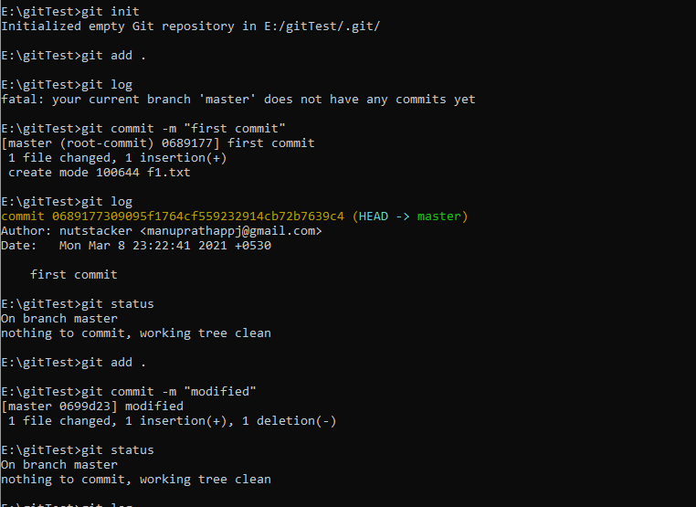

Slide 13
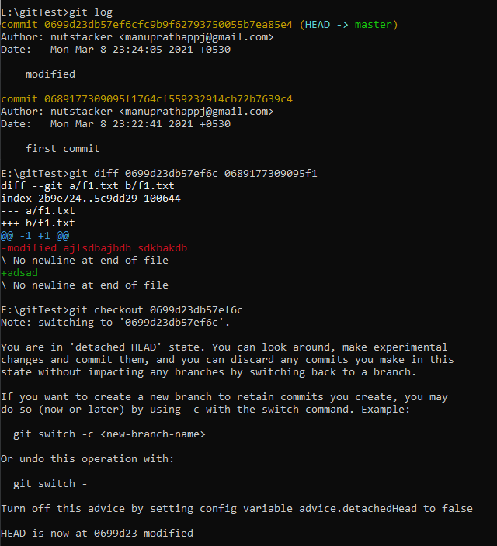

Slide 14
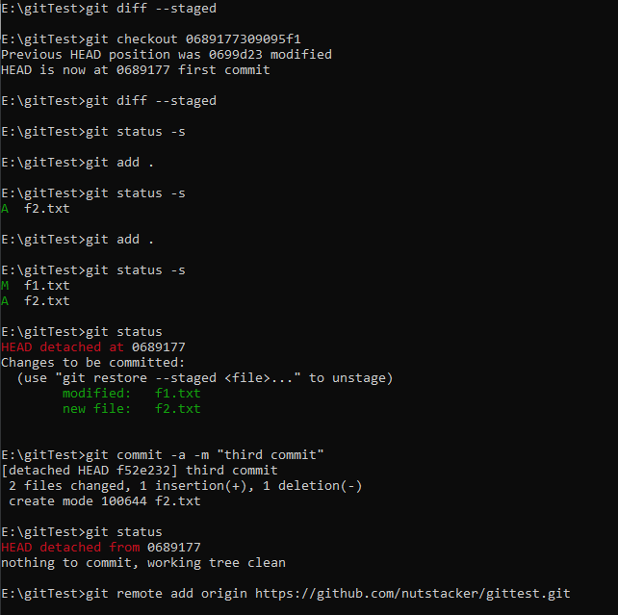

Slide 15
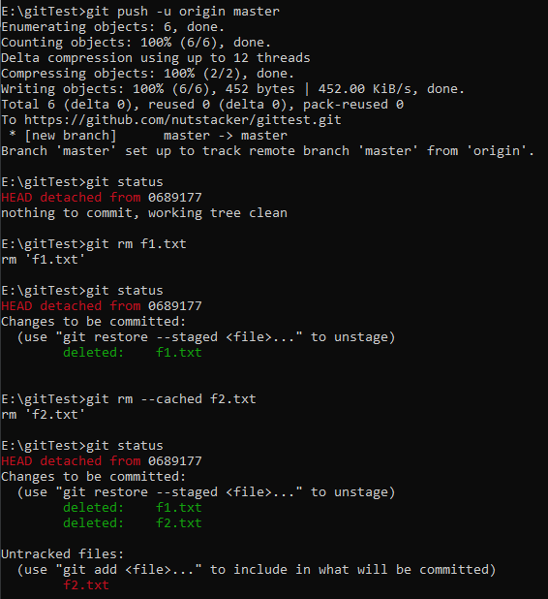

Slide 16
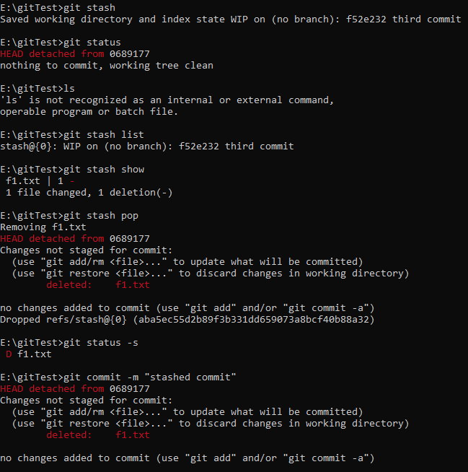

Slide 17
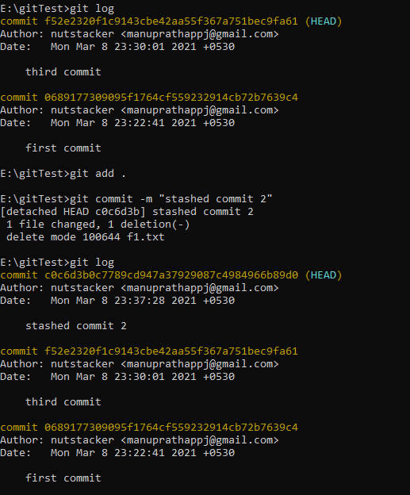

Slide 18
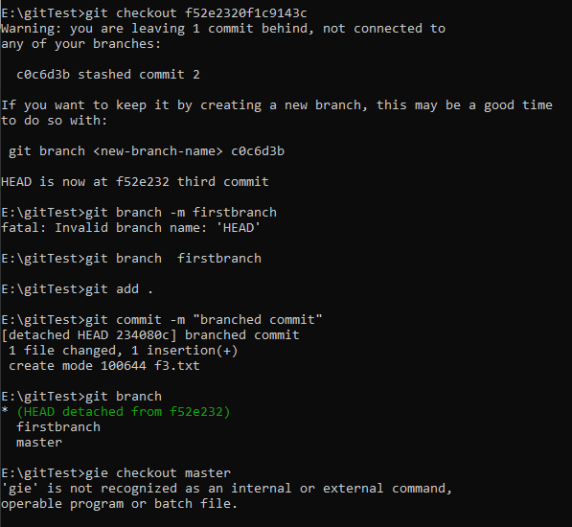

Slide 19
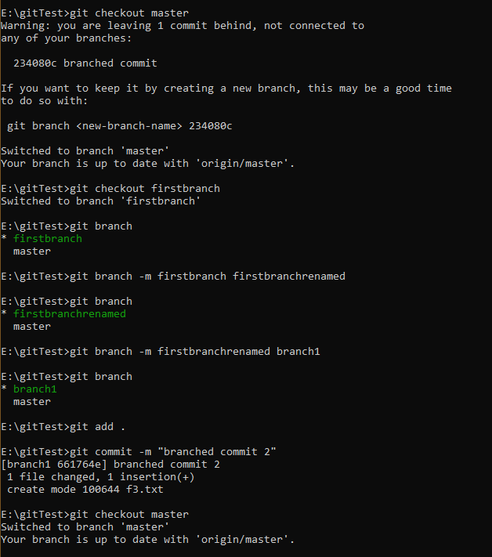

Slide 20
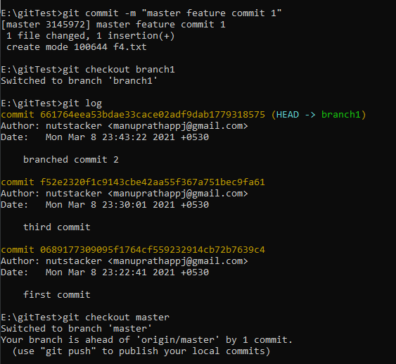

Slide 21
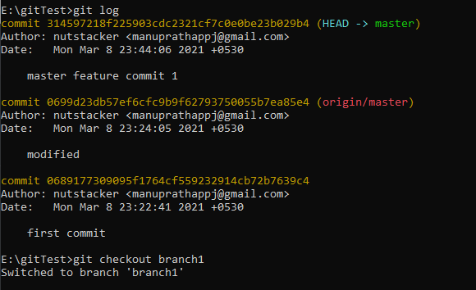
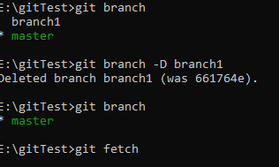

Slide 22
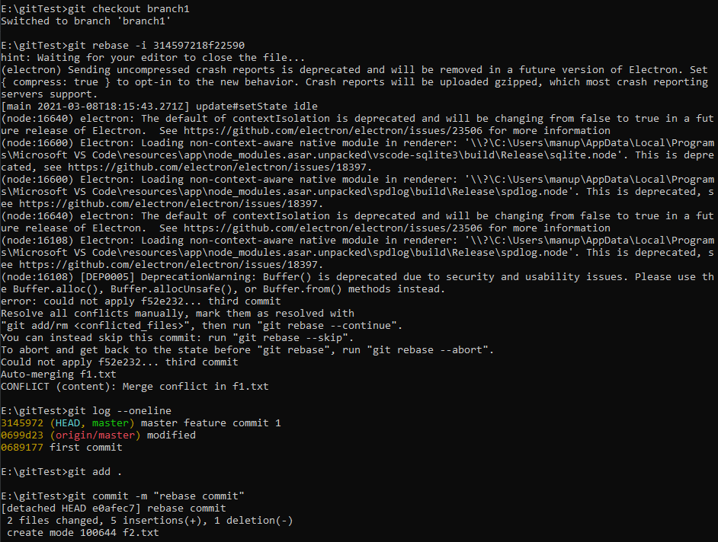

Slide 23
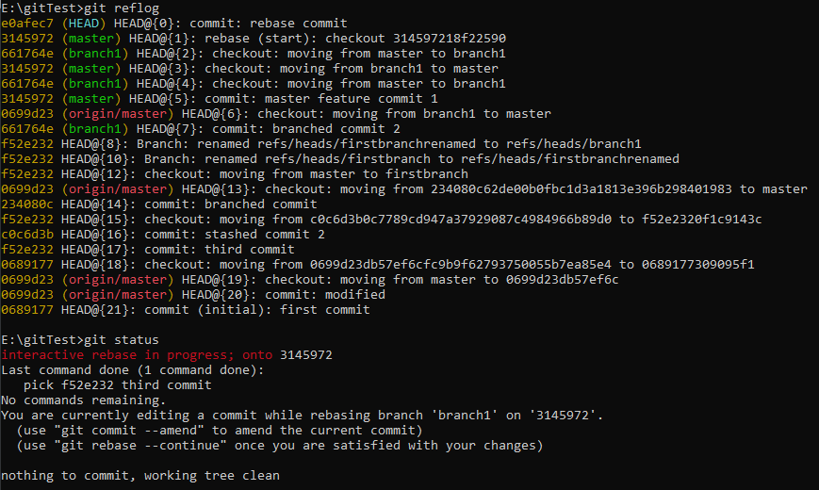

Slide 24
